Slide 1
Canada’s Recognition and Implementation of Indigenous Rights Framework

Slide 2
General Information
On February 14, 2018 Trudeau announced the Recognition and Implementation of Indigenous Rights Framework
The engagement process is currently underway and is expected to be completed in June – this timeframe is inadequate to properly address the issue
A draft bill is supposed to completed in fall 2018 and legislation is expected to be passed before the next federal election in 2019
If passed this legislation will be the basis for all negotiations and recognition of rights for all First Nations – the Indian Act will be abolished and replaced with rights derived from s. 35 of the Canadian Constitution
The Comprehensive Land Claims Policy and Inherent Right to Self-Government Policy will be replaced with this legislation

Slide 3
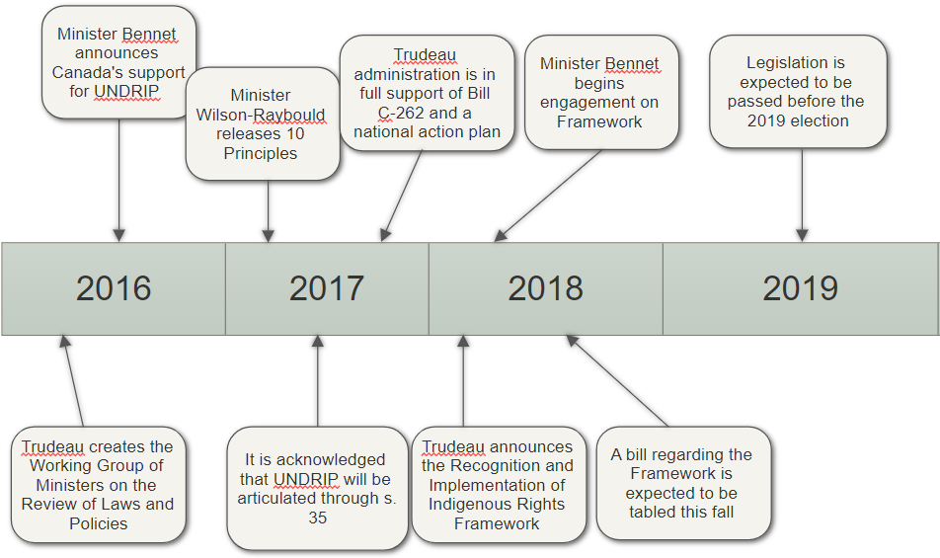
Timeline

Slide 4
Federal Framework: Two Main Components
1. Indigenous Self-Government
2. New Fiscal Relationship

Slide 5
1. Indigenous Self-Government
The core of the planned Framework is to merge bands currently under the Indian Act into federally recognized “Indigenous Governments”
The aim is to create 40-50 Indigenous self-governing bodies across Canada along ethno-linguistic lines (Cree, Ojibway, Algonquin, Mohawk, etc.), essentially creating a 3rd order of government
Trudeau’s government will not consider opening the Constitution so all rights will be derived from s. 35 of the Constitution Act, 1982
Budget 2018 set aside $101.5 million to achieve these ends

Slide 6
2. A New Fiscal Relationship
A new fiscal relationship between the Federal Government and the new federally recognized “Indigenous Governments” will be developed
Budget 2018 has set aside $377.8 million to develop and begin implementation of the new fiscal policy
The Carrot and Stick Approach
Carrot: Jurisdiction over programs and services and a significant amount of funding to run them. Concern: adequate funding is not guaranteed, especially in the long-term.
Stick: First Nations that remain under the Indian Act may find it harder to access service dollars as more First Nations opt-in to the new fiscal relationship
The Department of Indigenous Services, which continues to provide funding for services to bands, will cease to exist once all First Nations become part of the new system.

Slide 7
What’s on the Table
As the Indian Act is replaced, Indigenous Self-Governments will take over certain jurisdictions currently under federal and provincial control
The Federal Government has stated they see “...the scope of Aboriginal jurisdiction as likely extending to matters that are internal to the group, integral to its distinct Aboriginal culture, and essential to its operation as a government or institution.”
Jurisdictions up for negotiation include:
Establishment of governing structures, elections, and leadership selection processes
Membership, marriage, adoption, and child welfare
Education, health, and social service provision
Administration and enforcement of laws which may include certain criminal laws
Policing, penitentiary and parole
Environmental protection and assessment, fisheries co-management, and gaming

Slide 8
Canada’s Proposal: Indigenous Third Order of Government
Indigenous Jurisdiction
Federal Jurisdiction
Provincial Jurisdiction

Slide 9
What’s Not on the Table
First Nations who agree to enter an Indigenous Self-Government arrangement would have authority delegated to them by the central government and would be subject to the Canadian Constitution (3rd order of government)
This is not full sovereignty and it would therefore be impossible to have a true nation-to-nation relationship with other governments or fully exercise:
The right to self-determination
Free, prior, and informed consent on First Nations traditional territory
The right to have treaties recognized as international instruments
Pre-existing jurisdiction and inherent rights
The Framework, as guided by the 10 Principles, is the Federal Government’s attempt to harmonize a watered-down version of UNDRIP with Canadian law. Full implementation of UNDRIP is also off the table.

Slide 10
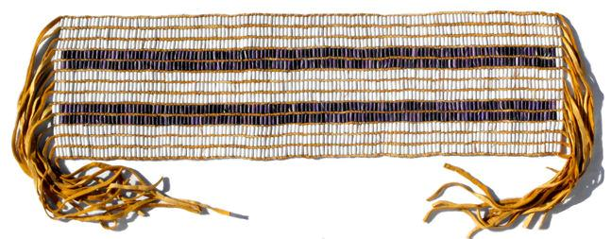
Nation-to-Nation
Indigenous Jurisdiction
Crown Jurisdiction
Canada is proposing we abandon our canoe and jump in their ship

Slide 11
Unknowns
What will happen to Reserve Lands?
What will happen with Indian Status?
What will the composition of the “Indigenous Governments” look like?
What would the new funding arrangements look like?
Will the situation be similar to the Inuit Land Claim Agreement that created the Territory of Nunavut in 1999?

